Slide 1
Clustering of Multiple Instance Data Andrew Karem Multimedia Research Lab Advisor: Dr. Hichem Frigui

Slide 2
Outline
Background
Multiple Instance Learning Framework (MIL)
Target Concepts and Diverse Density
Contributions
1. Optimizing Multi-concept MDD Metrics
Crisp Clustering of Multiple Instance Data (CCMI)
Fuzzy Clustering of Multiple Instance Data (FCMI)
Possibilistic Clustering of Multiple Instance Data (PCMI)
2. Negative Target Concepts
3. Embedded Feature Space Classification using Positive and Negative TCs.
Results and Analysis
Conclusions

Slide 3
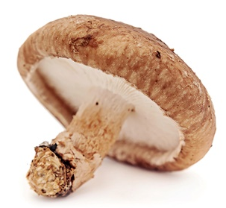
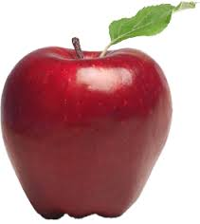
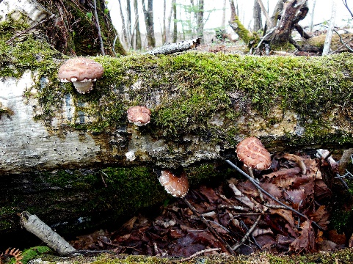
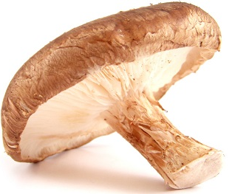
Conventional Classification
Objective: Train a classifier to answer the question
“Is this object a mushroom?”
Single Instance Learning
Training Data
Feature
Extraction
1 to 1
x₁=[x₁₁, x₁₂, .., x_{1m}]
Learning
L=1
1 to 1
x₂=[x₂₁, x₂₂, .., x_{2m}]
L=0
1 to 1
x₃=[x₃₁, x₃₂, .., x_{3m}]
L=1

Slide 4
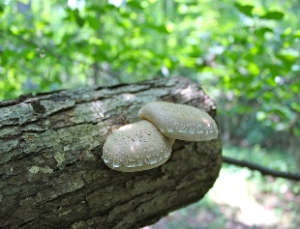



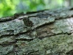
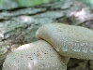

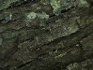
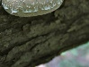











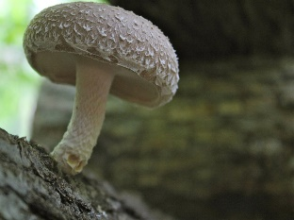
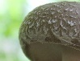





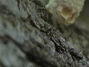


Train classifier to answer question
“Does this image contain mushrooms?”
Training Data
Feature
Extraction
Multiple Instance
Learning (MIL)
r₁
r₂
r₃
r₄
r₅
r₆
r₇
r₈
r₉
L=1
Learning
r₁
r₂
r₃
r₄
r₅
r₆
r₇
r₈
r₉
L=0
r₁
r₂
r₃
r₄
r₅
r₆
r₇
r₈
r₉
L=1

Slide 5
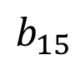
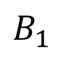
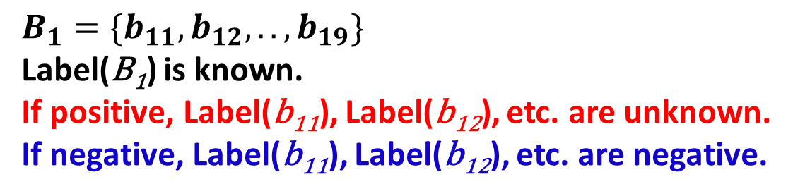
MIL Terminology
r₂
r₃
r₁
r₂
r₃
r₇
r₁
r₄
r₅
r₆
r₆
r₅
r₇
r₈
r₉
r₄
r₈
Bag
r₉
$$B_{1}$$
Instance
$$b_{15}$$
$$B_{1}=\{b_{11},b_{12},..,b_{19}\}$$
Label(B₁) is known.
If positive, Label(b₁₁), Label(b₁₂), etc. are unknown.
If negative, Label(b₁₁), Label(b₁₂), etc. are negative.

Slide 6



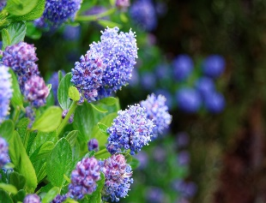







Instance Feature Space
And Target Concepts
`
Positive Samples
(Bags)
Feat 2
Negative Samples
(Bags)
Target Concept t
Feat 1

Slide 7
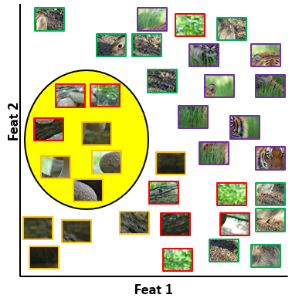
Diverse Density (DD) Algorithm*
Idea: Locate target concept (e.g. mushroom concept)
*Maron, Oded, and Tomás Lozano-Pérez. "A framework for multiple-instance learning." Advances in neural information processing systems (1998): 570-576.
Notes:
Maximize likelihood with positive bags, minimize likelihood of negative bags.

Slide 8
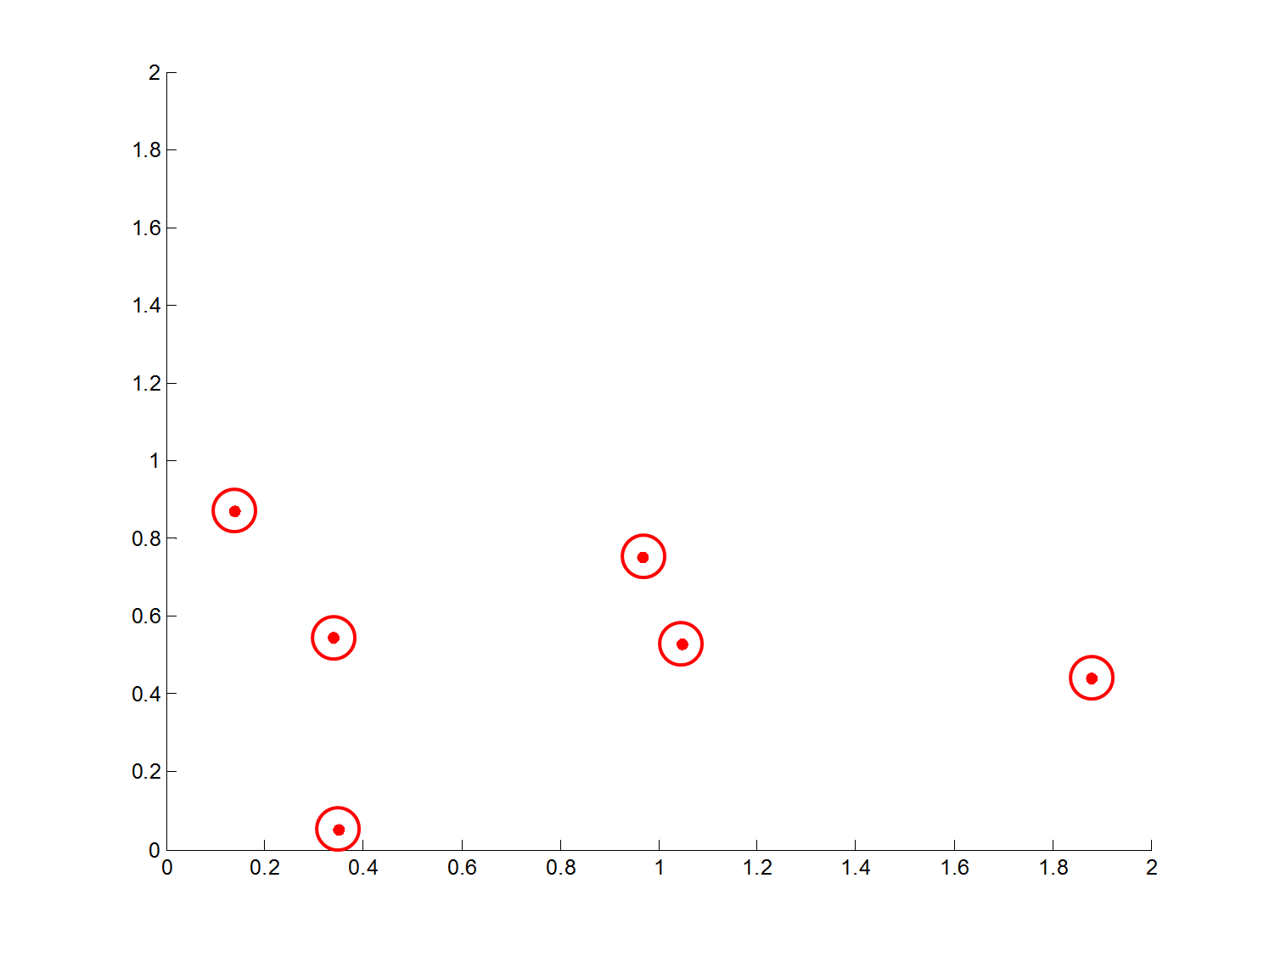
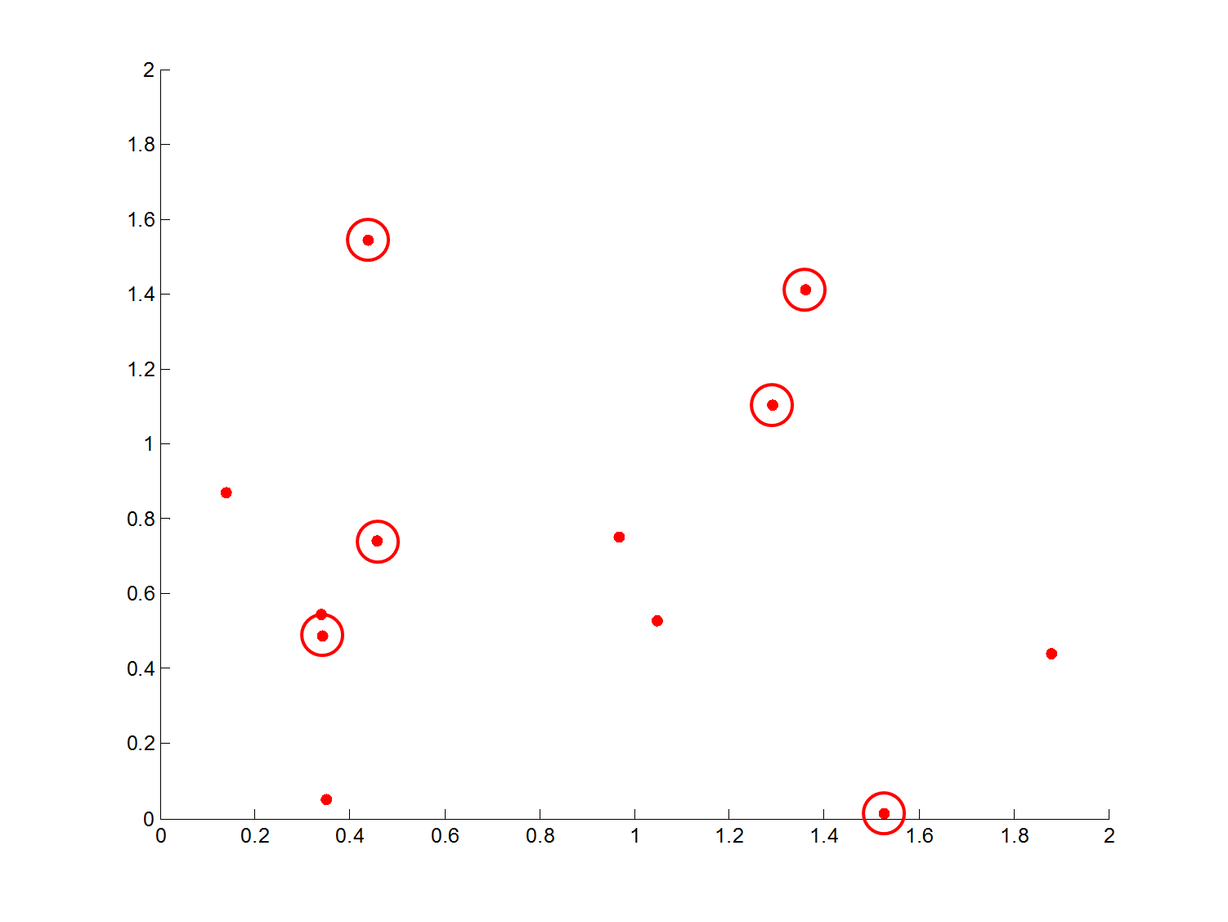
Synthetic Data-1TC
Instances of Positive Bags
Instances of Negative Bags
True Concept Region
Feat 2
Feat 1

Slide 9
DD and Data-1TC
Instances of Positive Bags
Instances of Negative Bags
True Concept Region
Initial Target Concept 1
Final Target Concept 1

Slide 10
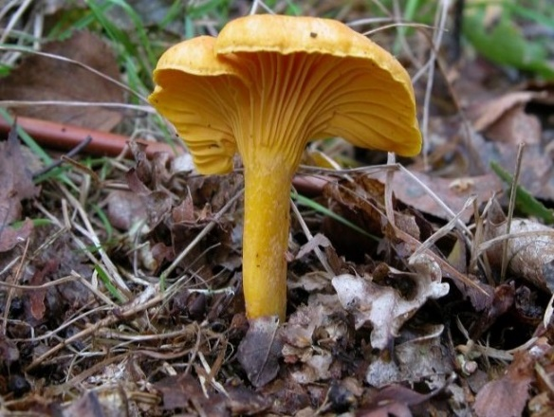
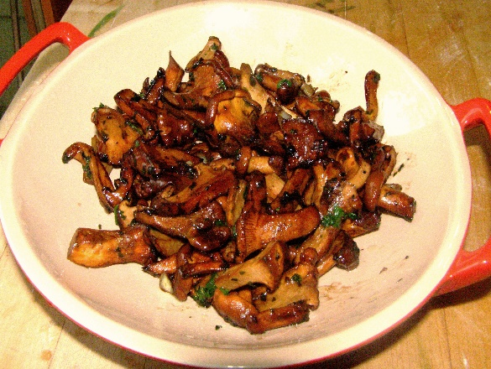
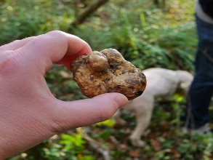

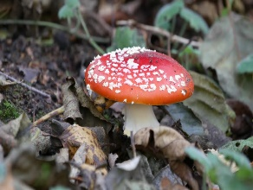

Not all mushrooms are created equal.

Slide 11
Limitation of DD
For classes with high intra-class variation, one target concept is not sufficient.
In this case, we require multiple target concepts to correctly model the data.
Author of DD recommends running algorithm with multiple initializations.
In our experiments this doesn’t work.

Slide 12
Proposed Work: Fuzzy Multiple Concept Diverse Density (FMDD)
Assume we have K target concepts t₁, t₂,…, t_{K}.
Any bag B_{n} can belong to any concept t_{k} with membership u_{kn}
constraints and

Slide 13
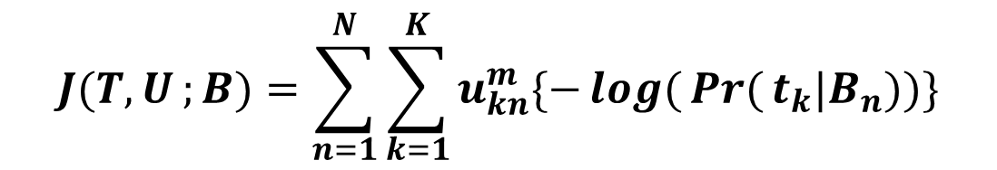
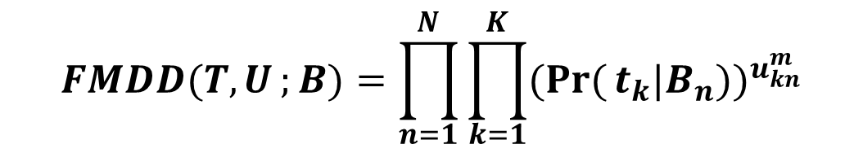
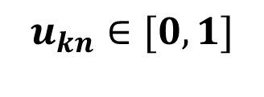
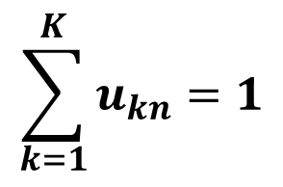
Proposed Work: Optimizing the FMDD
Objective: Find t₁,…, t_{K} that maximize
$$FMDD(T,U;{B})=\prod_{n=1}^{N}{\prod_{k=1}^{K}{(\operatorname{Pr}{(}t_{k}|B_{n}))^{u_{kn}^{m}}}}$$
$$\sum_{k=1}^{K}{u_{kn}}=1$$
subject to and
$$u_{kn}∈[0,1]$$
Equivalent to minimizing negative log-likelihood:
$$J(T,U;{B})=\sum_{n=1}^{N}{\sum_{k=1}^{K}{u_{kn}^{m}\{−\log{(}\operatorname{Pr}{(}t_{k}|B_{n}))\}}}$$
Notes:
Rewrite FMDD into simpler form with consolidated positive and negative densities
Easier to minimize the negative log-likelihood

Slide 14
Bag and Instance Probabilities
NOISY-OR
Point-and-Scale
l=1:L are the individual instance features.
s_{y}
y
c_{x}
s_{x}
b_{n1}
c_{y}
x

Slide 15
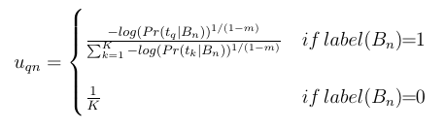
Fuzzy Clustering of Multiple Instance (FCMI) Algorithm
1) Initialize c₁ …c_{K} and scales s₁ …s_{K} for t₁ …t_{K}
2) Repeat
2a) Compute U.
2b) For each target concept t_{k}, k=1..K
Repeat
Use gradient descent to optimize c_{k} and s_{k}. Until c_{k} does not change significantly.
Until no centers change significantly.
3) Return centers, scales, and memberships.
Notes:
1) Line search uses all derived partial derivatives

Slide 16
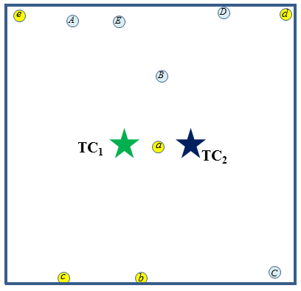
Membership ambiguities with the Fuzzy Membership
B1={A,B,C,D,E}
B2={a,b,c,d,e}
u₁₁ ≈ u₂₁ ≈ 0.5
u₁₂ ≈ u₂₂ ≈ 0.5

Slide 17
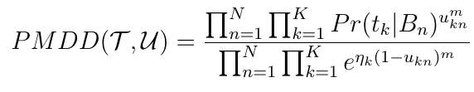
Proposed Work: Possibilistic Multiple Concept DD (PMDD)
We relax the membership constraint that

Slide 18
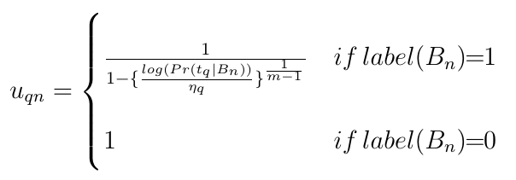
Possibilistic Clustering of Multiple Instance (PCMI) Algorithm
1) Initialize c₁ …c_{K} and scales s₁ …s_{K}.
2) Repeat
2a) Compute U.
2b) For each target concept t_{k}, k=1..K
Repeat
Use gradient descent to optimize c_{k} and s_{k}. Until c_{k} does not change significantly.
Until no centers change significantly.
3) Return centers, scales, and memberships.
Notes:
1) Line search uses all derived partial derivatives

Slide 19
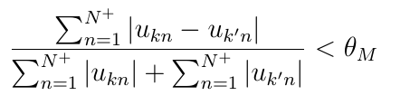
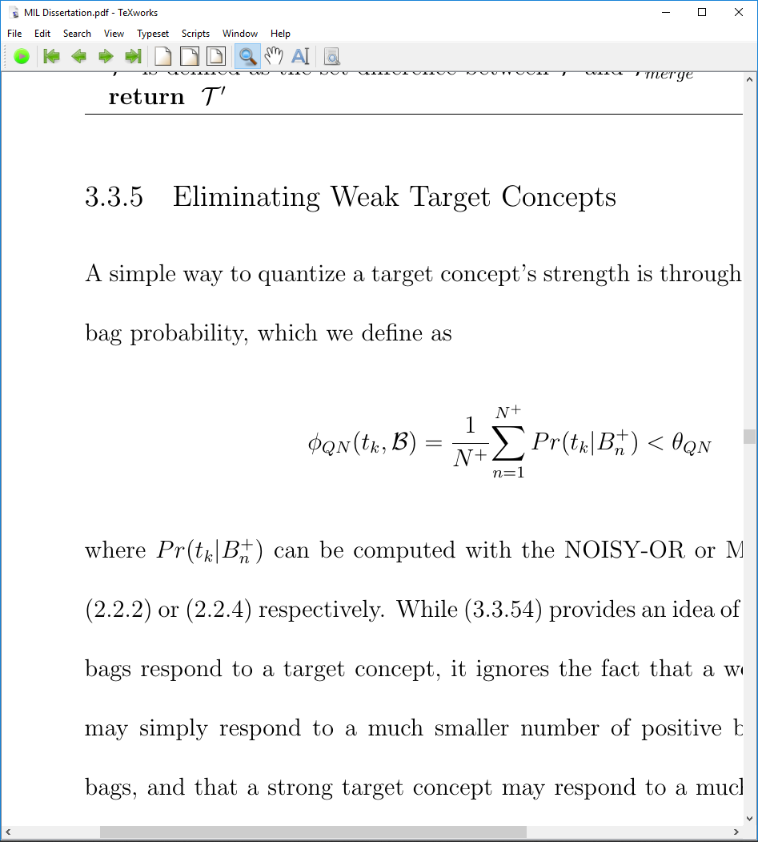
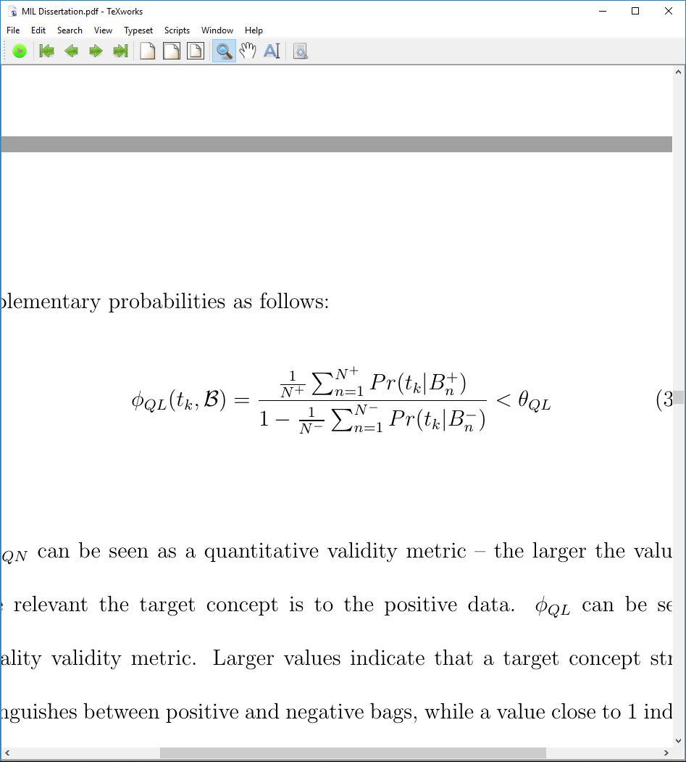
Identifying Optimal Number of TC
Run PCMI with over-specified number of TC.
Merge compatible TCs.
Eliminate TCs with limited positive bag response.
Eliminate TCs dominated by negative bag response.

Slide 20
Results and Analysis: Illustrative Datasets

Slide 21
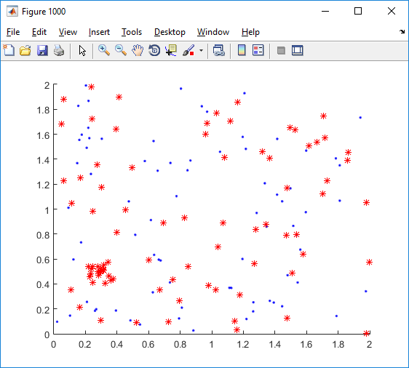
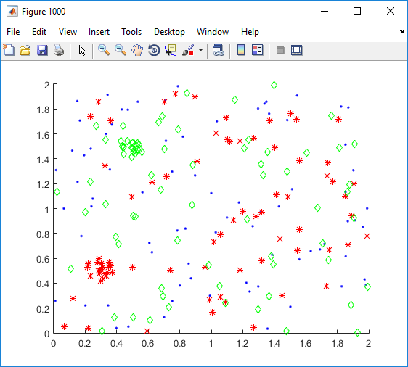
Illustrative Data Analysis
Compare performance of FCMI and PCMI to DD.
Data-1TC: Single target concept, 20 positive bags, 20 negative bags
Data-2TC: Two target concepts, 20 positive bags each, 20 negative bags

Slide 22
Experimental Results: Data-1TC
 | DD | FCMI (K=1) | FCMI (K=2)*
Correct TrueC | 74% | 74% | 86%
TrueC Failure | 26% | 26% | 14%
*After PCMI, Merging, and Weak TC Elimination
M
Notes:
1) 50 runs

Slide 23
Experimental Results: Data-2TC
 | DD | FCMI (K=2) | FCMI (K=4)* | FCMI (K=2)**
2 Correct TrueC | N/A | 46% | 88% | 100%
1 Correct TrueC | 0% | 20% | 12% | 0%
TrueC Midpoint | 62% | 22% | 0% | 0%
TrueC Failure | 38% | 12% | 0% | 0%
*After PCMI, Merging, and Weak TC Elimination
*KDE-based Initialization
E
M
Notes:
1) 50 runs

Slide 24
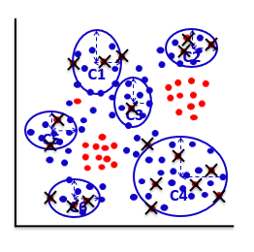
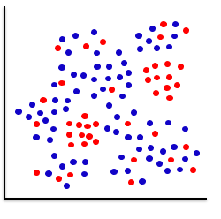
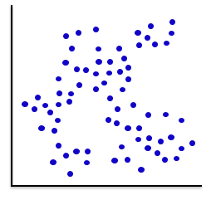
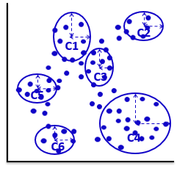
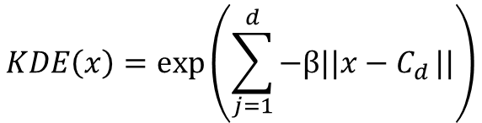
KDE Initialization and Negative TCs
$$KDE\left(x\right)=exp⁡\left(\sum_{j=1}^{d}{−β||x−C_{d}}||\right)$$
Cluster all negative instances.
Instances from positive bags
Instances from negative bags
Feat2
Feat2
Feat1
Feat1
Mark any instance x from positive bags
for which KDE(x)>θ_{KDE}.
Cluster remaining “likely positive” instances.

Slide 25
Results and Analysis: Sensitivity Datasets

Slide 26
How does the FCMI respond to changes in data generation parameters?
We generated 1100 datasets corresponding to 11 parameters and 10 distinct values per parameter.
Bag Quantity Parameters: Changes to the ratio of positive and negative bags
Positive Instance Distribution Parameters: Changes to the shape of the true concept distribution.
Data Dimensionality Parameters: Changes to the number of features, number of true concepts, and instances per bag.

Slide 27
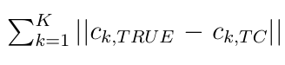
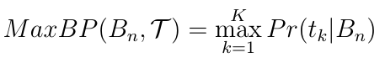
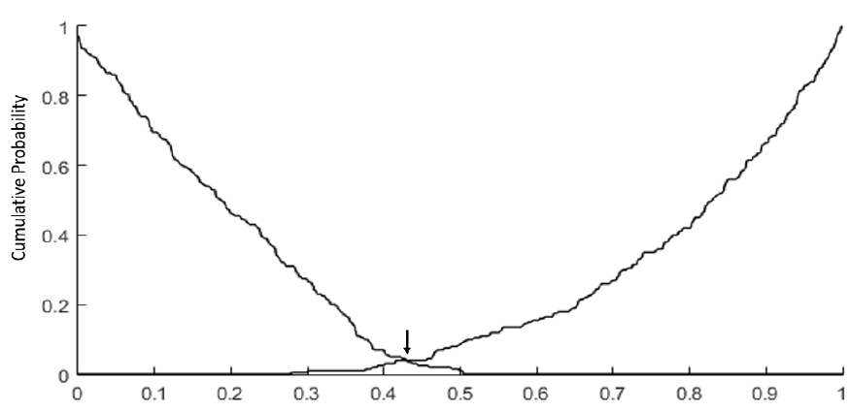

Three Performance Measures
Mean Centroid Error:
Positive/Negative Bag Probability Overlap:
RAND Index (Assigned vs True Concept Mismatches)
Use both FCMI-derived TCs and approximate “True” TCs based on generative parameters.
1-p(t|B⁻)
p(t|B⁺)

Slide 28
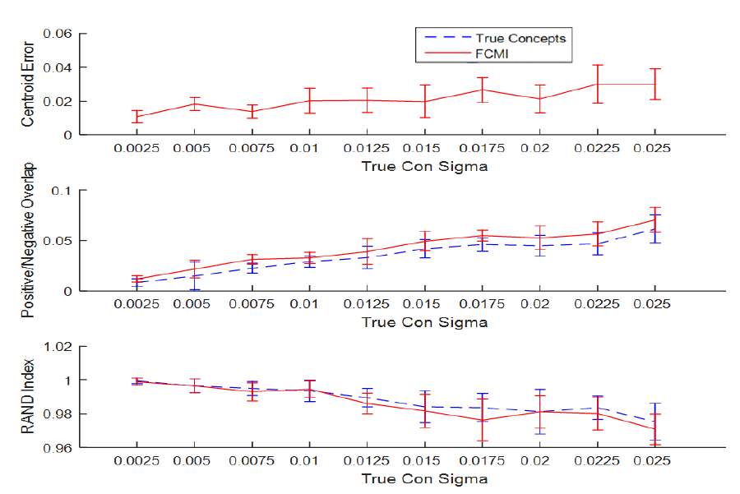
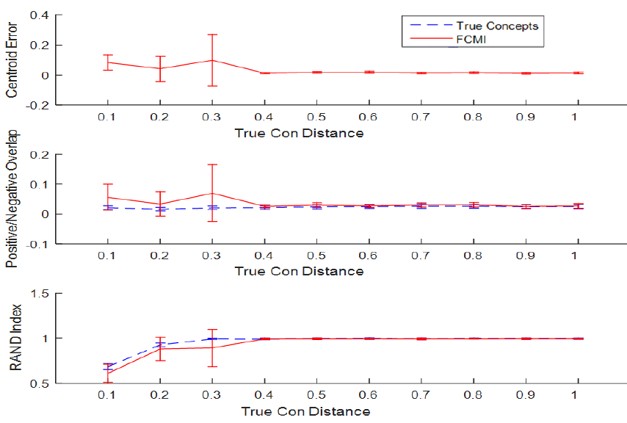
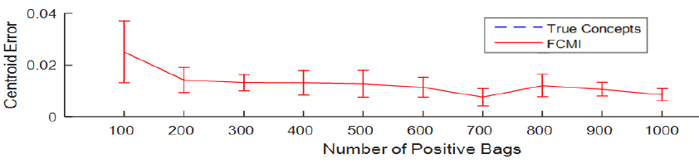
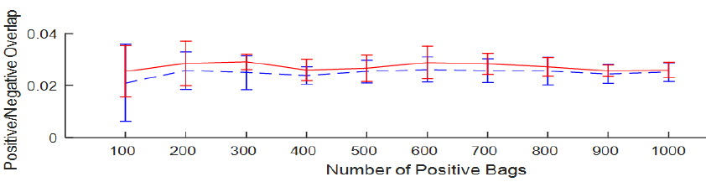
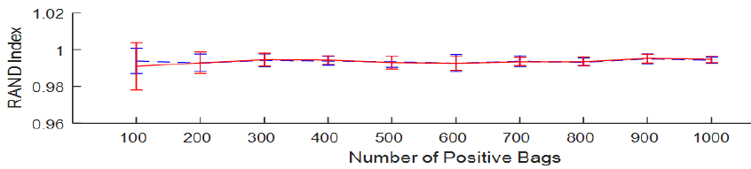
Sensitivity Results

Slide 29
Application to Buried Explosive Object Detection (BEO)

Slide 30
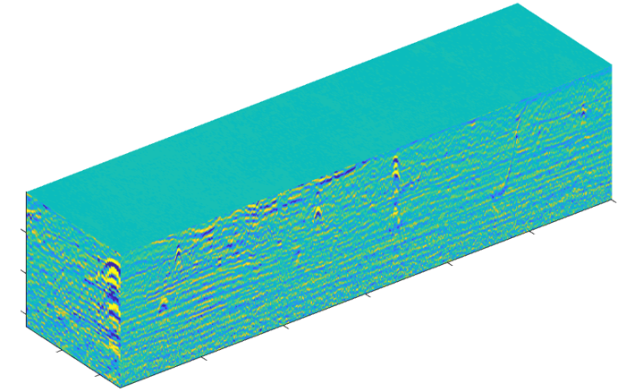


BEO GPR Collection System
GPR Data Volume
Cross-track
Downtrack
Feature Extraction
Discrimination Algorithm
Threat?
(probability of threat)
Prescreener alarm data volume

Slide 31





BEO Data: The EHD Feature
Sample BEO Alarm GPR Data
y (down-track)
x (cross-track)
DT
CT
z (depths)
Hyperbolic Shape Consistent with presence of BEO.
x15

Slide 32

Most Discriminative Features

Slide 33
BEO Clustering Experiment
Data consist of 500 Diverse BEOs and 500 FA.
FCMI run with only the most discriminative EHD features with 10 TC.
1st goal was to locate clusters with distinctive BEO types and characteristics.
2nd goal was to investigate viability of using Embedded Feature Space-based classification with the TCs.

Slide 34

Distinctive BEO Clusters
Target Concept 3
Inner
Inner
Outer
Outer
Outer

Slide 35

Distinctive BEO Clusters
Target Concept 4
Outer
Outer
Outer
Inner
Inner

Slide 36

Distinctive BEO Clusters
Target Concept 5
CT
DT

Slide 37














Embedding Features with TCs
Min dist
Max dist
$$t1$$
$$x_{1}$$
$$t_{1}^{−}$$
$$x_{1}^{−}$$
$$t2$$
$$x_{2}$$
$$t_{2}^{−}$$
$$x_{2}^{−}$$
…
…
…
…
$$tK$$
$$x_{K}$$
$$t_{L}^{−}$$
$$x_{L}^{−}$$
$x_{1},x_{2}$, …, $x_{K}$, $x_{1}^{−}$, $x_{2}^{−},$…,$x_{L}^{−}$

Slide 38
Benchmark Results (AUC)
MUSK 1
MUSK 2
ELEPHANT
FOX
TIGER
EFCMI
-
CKNN
.9279
.9078
.9074
.6654
.8281
EFCMI
-
SVM
.9338
.9341
.
9203
.6761
.8172
EFCMI
-
ONS
.9480
.9263
.8808
.6955
.7962
DD
-
SVM
.9626
.9683
.8877
.6564
.7635
1
MILES
.9428
.9560
.9018
.6955
.
2
9172
¹Chen, Y., & Wang, J. Z. (2004). Image categorization by learning and reasoning with regions. Journal of Machine Learning Research, 5(Aug), 913-939.
²Chen, Y., Bi, J., & Wang, J. Z. (2006). MILES: Multiple-instance learning via embedded instance selection. IEEE Transactions on Pattern Analysis and Machine Intelligence, 28(12), 1931-1947.

Slide 39

BEO Results
EHD-KNN:
Frigui, H., & Gader, P. (2009). Detection and discrimination of land mines in ground-penetrating radar based on edge histogram descriptors and a possibilistic $ k $-nearest neighbor classifier. IEEE Transactions on Fuzzy Systems, 17(1), 185-199.

Slide 40
Conclusions
Proposed CMDD, FMDD, and PMDD metrics adapted from principles of Clustering Theory and the DD metric, and proposed the CCMI, FCMI, and PCMI algorithms to optimize CMDD, FMDD, and PMDD metrics.
Used two synthetic data experiments to compare our algorithms to DD and test robustness to parameter changes.
Demonstrated FCMI could locate diverse clusters of BEOs using a set of discriminative features.
Proposed classifier construction based on learned positive and negative TCs, and Embedded Feature Space.
Applied the EFCMI-based classifiers to Benchmark data and BEO data and demonstrated them to be competitive with existing approaches.

Slide 41
Publications
Malof, J. M., Reichman, D., Karem, A., Frigui, H., Ho, D. K., Wilson, J. N., ... & Collins, L. M. (2018). A large-scale multi-institutional evaluation of advanced discrimination algorithms for buried threat detection in ground penetrating radar. IEEE Transactions on Geoscience and Remote Sensing
Karem, A., Trabelsi, M., Moalla, M., & Frigui, H. (2018, April). Comparison of several single and multiple instance learning methods for detecting buried explosive objects using GPR data. In Detection and Sensing of Mines, Explosive Objects, and Obscured Targets XXIII (Vol. 10628, p. 106280G). International Society for Optics and Photonics.
Karem, A., & Frigui, H. (2016, December). Multiple Instance Learning with multiple positive and negative target concepts. In 2016 23rd International Conference on Pattern
Karem, A., Khalifa, A. B., & Frigui, H. (2016, May). A fisher vector representation of GPR data for detecting buried objects. In Detection and Sensing of Mines, Explosive Objects, and Obscured Targets XXI (Vol. 9823, p. 98231C). International Society for Optics and Photonics.
Karem, A., & Frigui, H. (2015, August). Fuzzy clustering of multiple instance data. In 2015 IEEE International Conference on Fuzzy Systems (FUZZ-IEEE) (pp. 1-7). IEEE.
Patrick Corbett, Yetu Yachim, Andrea Ascuena, and Andrew Karem (2013). Understanding nextGen students' information search habits: A usability perspective. In R. McClure & J. Purdy (Eds.), The New Digital Scholar: Exploring and Enriching the Research and Writing Practices of NextGen Students. American Association of Information and Science Technology.
Karem, A., & Frigui, H. (2011, July). A multiple instance learning approach for landmine detection using ground penetrating radar. In 2011 IEEE International Geoscience and Remote Sensing Symposium (pp. 878-881). IEEE.
Karem, A., Fadeev, A., Frigui, H., & Gader, P. (2010, April). Comparison of different classification algorithms for landmine detection using GPR. In Detection and Sensing of Mines, Explosive Objects, and Obscured Targets XV (Vol. 7664, p. 76642K). International Society for Optics and Photonics.
Frigui, H., Fadeev, A., Karem, A., & Gader, P. (2009, May). Adaptive edge histogram descriptor for landmine detection using GPR. In Detection and Sensing of Mines, Explosive Objects, and Obscured Targets XIV (Vol. 7303, p. 730321). International Society for Optics and Photonics.

